Slide 1
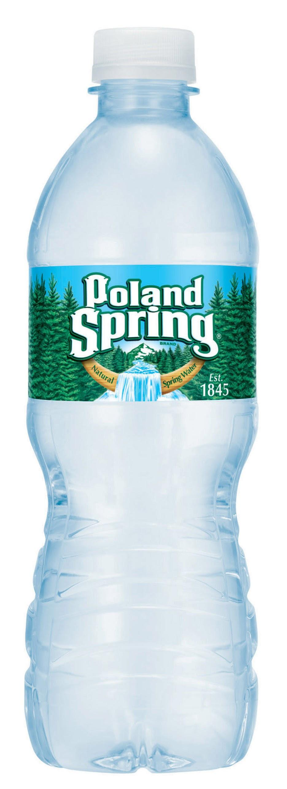
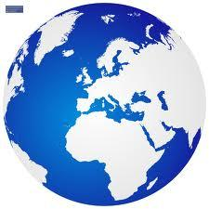
The Life Of Walter Bottle
By: Reymond Pamelar

Slide 2
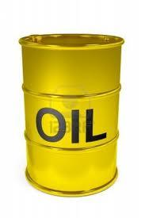
The Fetus Months
Once upon a time a soon to be mom, extracted a dad filling up 17 million barrels of oil.
17 Million Of These

Slide 3
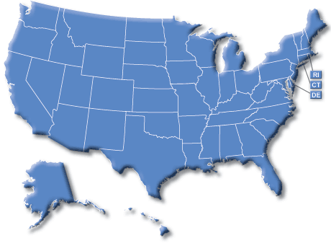
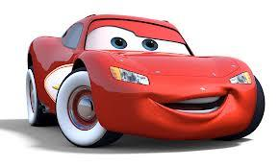
These 17 million oil barrels could be enough to fuel 1 million cars

Slide 4
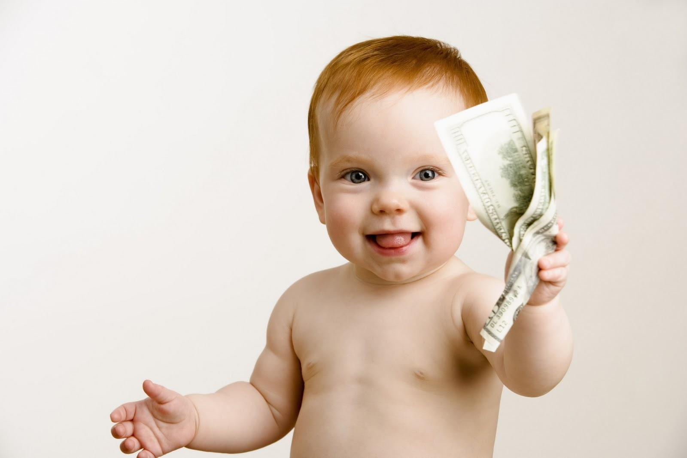
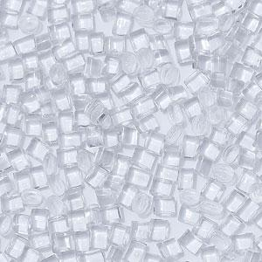
The Baby Years
After extraction, their oil was made into plastic pellets. Mr. and Mrs. Bottle then named their product Walter Bottle as his name held a destiny. A couple months later,his mom died from a second attempt in trying to extract oil. I guess producing more plastic IS dangerous to the people of earth.
Plastic (Walter)

Slide 5
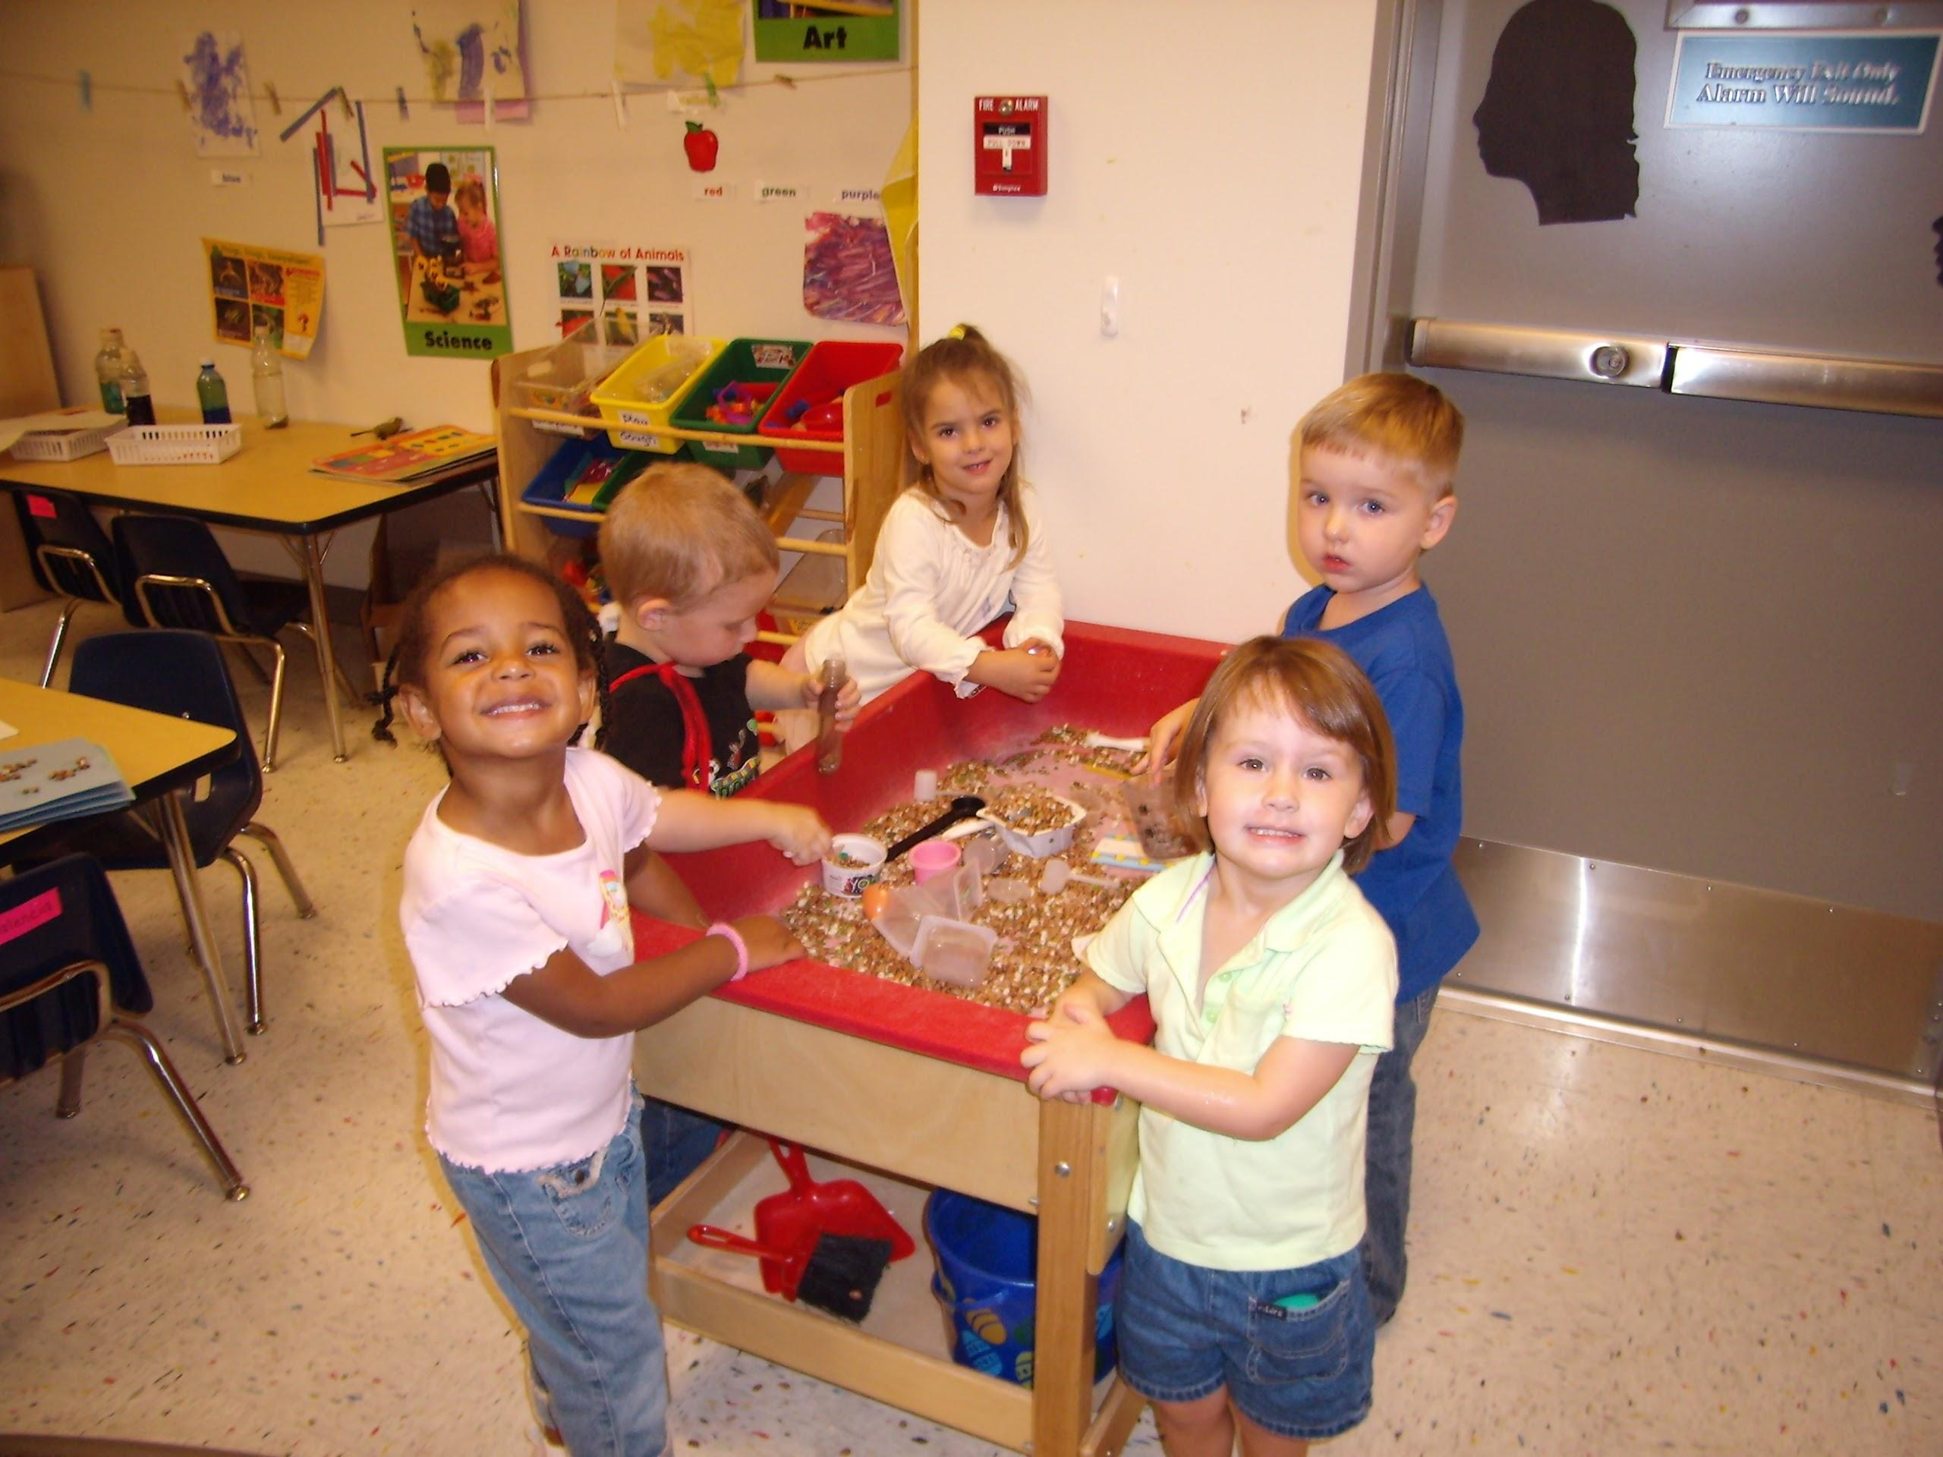
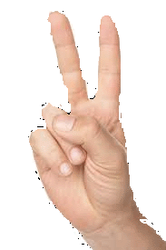
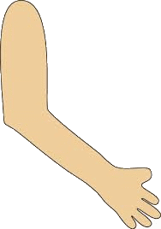
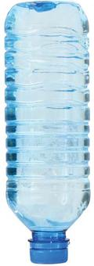
Walter Bottle’s Childhood
His dad could not afford a proper home for his newborn, and so Walter grew up and was raised in a bottling center. This is where he got nurtured and later grew up into a little Bottle.

Slide 6
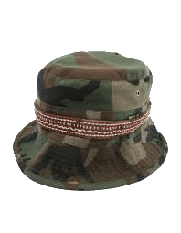
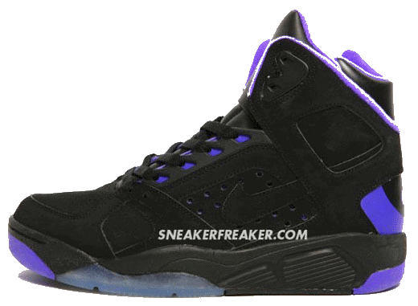
As a Teenager:
Walter was a pretty popular teenager. He also knew how to dance. They labeled him “Poland Spring” because his moves were so clean and fresh. As a teen, he was so active in dancing which required him to fill up with a lot of water.

Slide 7
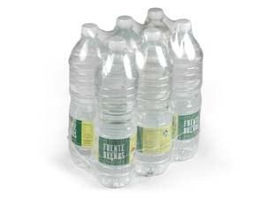
College
Still being able to keep up with school, Walter went on to college where he met some friends. He found that they were related to him as they were also Bottles. With common interest, they traveled around the world in a plastic covered plane.
Plastic Airlines

Slide 8
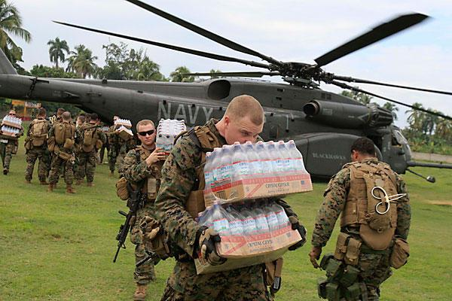
A Bottle’s Duty
Walter Bottle later found a job that suited him as he also got to be with his friends and be himself. Together they fought world thirst on the front lines providing people with water.
Walter and his friends!

Slide 9
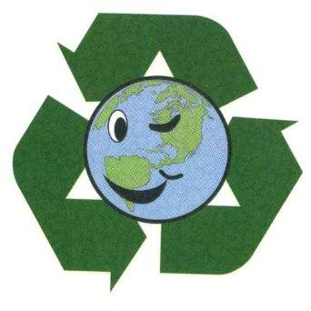
The Walter Bottle As Of Today
What happened to Walter’s dad? How did Walter end up looking like a water bottle? We may never know. But Walter Bottle never did find a companion, and though he intends to keep it that way with a cap held tight, his cycle goes on. Recycle kids, for only 30% of walter’s relatives live on.

