Slide 1
Ozone Depletion
A Newsletter Powerpoint

Slide 2
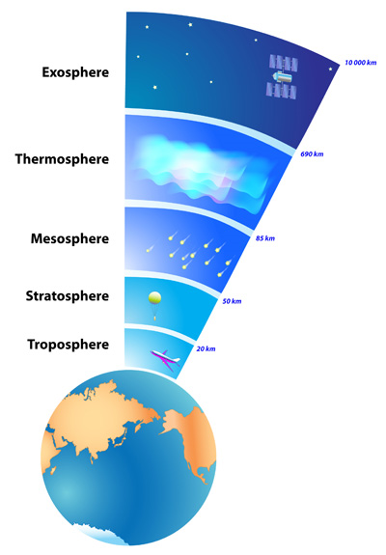
Ozone Depletion
Montreal Protocol: Because ozone depletion has become a severe problem within the last couple decades, this international treaty has been passed to decrease the levels of Ozone depleting substances (ODS) in our atmosphere. This treaty was signed in September 16, 1987 and signed to confirm by 197 other countries worldwide.
Ground-level Ozone vs. Stratospheric Ozone: Ozone is the protective layer located above the stratosphere that protects us from the suns harmful Ultraviolet (UV) radiation light. Because the depletion of ozone creates pathways for UV rays to hit Earth, this makes it a public risk to people in these areas more vulnerable to cataracts and skin cancer. these UV rays contribute to ground level ozone where smog is created and causes severe health issues including: eye irritation, lung cancer, inflammation. Environmental impacts associated with ground level ozone interferes with the plants ability to produce foods, weakening vegetation, producing less crop yields.
Layers of the atmosphere

Slide 3
Ozone Depletion
Solutions to ground level ozone:
Carpooling reduces emissions by an individual and saves energy as well
Public Transportation: Bus, Train, etc.
Environmental friendly products such as diesel cars, or electric running automobiles
Solutions to the hole in the ozone: (Located above stratosphere to reflect harmful UV light rays)
Montreal Protocol
Kyoto Protocol: Sets standards for industrialized countries to reduce greenhouse gas emissions
Education
Clean Air Act

Slide 4
Causes of Global Climate Change
There are many greenhouse gasses in the atmosphere. They include Carbon Dioxide at 77%, Methane at 14%, and Nitrous Oxide at 8%. The greenhouse effect is when heat from the sun gets trapped in the atmosphere when it tries to get reflected back out. The EPA regulated pollutants are carbon monoxide, lead, nitrogen dioxide, particulate matter, ozone, and sulfur dioxide. El Nino is caused when the trade wind stops blowing and La Nina when it blows harder. These events change where and how much rain falls. The major kinds of fuels are coal, oil, natural gas, and wind and solar. Coal is cheap but is destructively extracted. Oil is liquid but pollutes a lot. Natural gas burns clean but has to be fracked if not originating from a landfill. Wind and solar are completely clean but do not produce a lot of power on a small scale.

Slide 5
Effects of Global Climate Change
Positive feedback loops are cycle in which one thing affects another and instead of adapting to it trying to maintain a median it is adversely affected so it continues to have a rise in the effect
Negative feedback loop- house heater going on and off to reach the equilibrium set
Positive feedback loop- country in poverty goes deeper into poverty because of lack of education, medicine and antenatal products causing a rise in population.
Industrial Smog- a gray smog that usual more common in colder, wetter regions and is produced by industrial processes such as burning coal
Photochemical smog- a secondary pollutant caused by the reaction between a climate with sunny conditions and thermal inversion AND pollutants like ozone. Because of the thermal inversion and the sunny conditions a layer of layer is trapped close to the earth causing pollutants like ozone to be at low attitudes that can be detrimental to life on earth.
Adverse changes with the temperature of the globe at a fast rate can negatively change ocean currents, wind patterns, migratory patterns, habitat size, biodiversity and ocean rising.

Slide 6
Effects on global Climate Change
Changes in precipitation can causing one of two things. Too much rain causing flooding, landslides, loss of habitat and, release of once controlled pollutants in an environment. ex, colorado mines releasing heavy metals more rapidly because of large amounts of snow.
Sea level rising is mostly due to increasing temperature causing the water molecules to expand taking up more surface area. The smaller reason is the melting of ice caps in both poles.
As the air and water temperature increase from greenhouse gasses we start to see a depletion in ice caps that then cause more melting, a positive feedback.
As we see a change in patterns from the old world to the new world not only does it affect the climate but we see a loss in biodiversity because of loss of habitat, lack of food/water, more desperate fisherman and being unable to adapt to the changes.
Proxy indicators are things that tell use what happening in the past and the trends between then and now. Proxy indicators are like tree rings, ice cores and coral reefs.

Slide 7
Solutions to Climate Change
The Kyoto Protocol to the United Nations Framework Convention on Climate Change is an international treaty that sets binding obligations on industrialized countries to reduce emissions of greenhouse gases.
Central to Kyoto policy is an arrangement in which emissions are capped and industry and governments are allowed to generate and trade emissions allowances or offsets.
Many see that the cost of the Kyoto Protocol outweighs the benefit. They say that is doesn’t go far enough to curb the greenhouse emissions
Some claim that reducing greenhouse gas emissions is an essential step to reversing global warming, and immediate multinational collaboration is needed if the world is to have any hope of preventing devastating climate changes.
Carbon setoff: A reduction in emissions of carbon dioxide or greenhouse gases made in order to compensate for or to offset an emission made elsewhere

Slide 8
Solution to Climate Change
Carbon offsets are measured in metric tons of carbon dioxide equivalent and may represent six primary categories of greenhouse gases which is carbon dioxide, methane, nitrous oxide, perfluorocarbons, hydrofluorocarbons, and sulfur hexafluoride.
One carbon offset represents the reduction of one metric ton of carbon dioxide or its equivalent in other greenhouse gases.

